Slide 1
SECURE DATA HIDING in IMAGE USING STEGANOGRAPHY
CAPSTONE PROJECT
Presented By:
Nithilan Valan
KPR Institute of Engineering and Technology
Computer Science and Engineering

Slide 2
OUTLINE
Problem Statement
Technology used
Wow factor
End users
Result
Conclusion
Git-hub Link
Future scope

Slide 3
Problem Statement
Traditional data transmission methods are vulnerable to interception, making sensitive information prone to unauthorized access. This project addresses the issue by implementing image steganography using LSB (Least Significant Bit) encoding, allowing users to embed confidential data within images in a way that is imperceptible to the human eye. Unlike encryption, which makes data transmission obvious, steganography conceals the existence of the data itself, adding an extra layer of security. By incorporating passcode-based authentication, the system ensures that only authorized users can retrieve the hidden message, making it an effective solution for secure communication and data privacy.

Slide 4
Technology used
1️⃣ Programming Language: Python Python was chosen for its simplicity, extensive libraries, and flexibility in handling image processing. It allows for easy implementation of steganography techniques with minimal code complexity while ensuring efficiency.
2️⃣ Libraries Used:
OpenCV: Handles image loading, modification, and saving. It provides efficient pixel manipulation, which is essential for embedding and extracting hidden messages without affecting the overall image quality.
NumPy: Used for numerical computations and efficient array operations. Since images are stored as multidimensional arrays, NumPy enables fast pixel access and bitwise operations, making the encryption and decryption process seamless.
3️⃣ Image Format: PNG
PNG was chosen because it supports lossless compression, meaning the hidden message remains intact without data loss. Other formats like JPEG use lossy compression, which alters pixel data and could distort the embedded message.
4️⃣ LSB (Least Significant Bit) Steganography
LSB steganography modifies the least significant bits of pixel values to embed data. Since these bits contribute the least to color variations, the changes are imperceptible to the human eye.
This method ensures high data security while maintaining the visual integrity of the image, making it an effective technique for covert communication.

Slide 5
Wow factors
🔹 Passcode Protection for Enhanced Security Unlike traditional steganography methods that simply embed messages in an image, this project incorporates passcode-based authentication. This means that even if someone gains access to the encrypted image, they cannot retrieve the hidden message without the correct passcode. This adds an extra layer of security and ensures only authorized users can decrypt the information.
🔹 Minimal Image Distortion for Undetectable Encryption The use of Least Significant Bit (LSB) steganography ensures that the changes made to the image are imperceptible to the human eye. By modifying only the least significant bits of the pixel values, the visual quality of the image remains virtually unchanged, making the presence of hidden data almost impossible to detect.
🔹 User-Defined Image Input for Greater Flexibility This project allows users to select any PNG image for encryption and decryption instead of hardcoding a specific file. This makes it more practical and versatile for real-world applications, allowing users to work with their own images without modifying the source code.
🔹 Standalone Execution with No External Dependencies Unlike cloud-based encryption solutions, this project runs entirely offline, ensuring that sensitive data remains private. Users do not need to rely on third-party services or internet connectivity, making it a secure and self-contained solution for confidential communication. The encryption and decryption codes are kept in separate files to suit the specific needs of the user.
🔹 Lightweight and Efficient Data Hiding Mechanism By using Python and NumPy, the encryption and decryption processes are executed quickly and efficiently, even for large images. The project is designed to be lightweight, requiring minimal computing resources while ensuring high performance and accuracy in data embedding and retrieval.

Slide 6
End users
🔹 Cybersecurity Professionals and Ethical Hackers This project provides a secure method of data transmission, which is crucial for cybersecurity experts who deal with sensitive information. Ethical hackers and security analysts can use this technique for covert communication and secure data exchange, ensuring that confidential data remains hidden from unauthorized entities.
🔹 Forensic Experts and Law Enforcement Agencies Law enforcement officials and forensic analysts often need to transmit or store sensitive case-related information without attracting attention. By embedding critical data inside images, investigators can securely share evidence or classified documents without raising suspicion, reducing the risk of interception.
🔹 Journalists, Activists, and Whistleblowers In regions where freedom of speech is restricted, journalists and activists face significant risks when sharing sensitive information. This steganography project allows them to conceal messages inside innocent-looking images, ensuring safe and discreet communication while protecting their sources.
🔹 Students and Researchers in Cryptography and Data Security This project serves as an educational tool for students and researchers interested in cryptography, steganography, and information security. It provides a hands-on approach to understanding how data can be hidden within digital media, making it a valuable resource for academic and research purposes.
🔹 General Users Concerned About Privacy With increasing concerns over data privacy and surveillance, everyday users can leverage this tool to securely store personal notes, passwords, or confidential documents inside images. This adds an extra layer of protection beyond traditional encryption methods, ensuring that private information remains truly hidden.

Slide 7
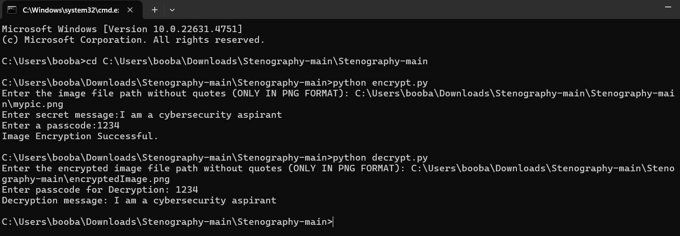
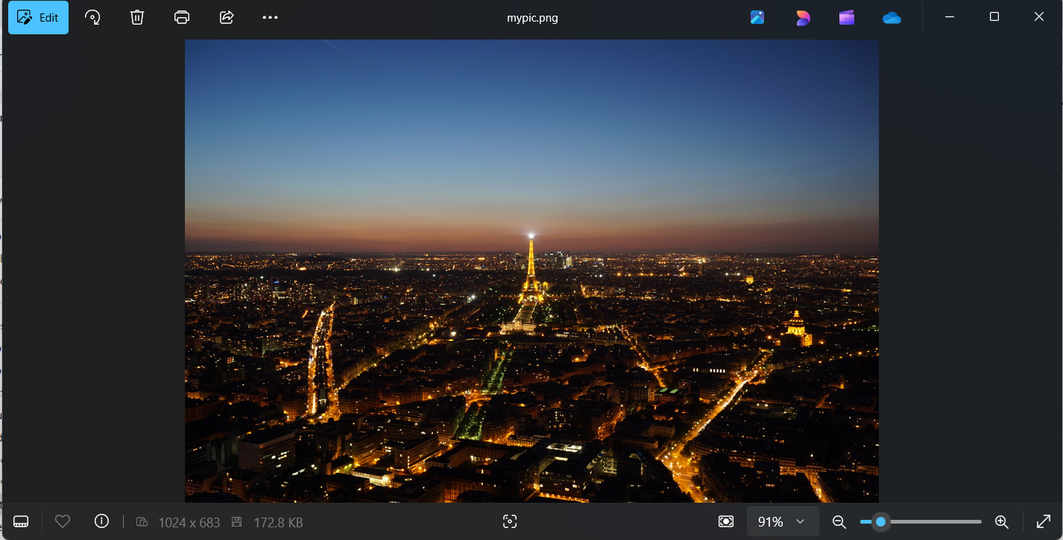
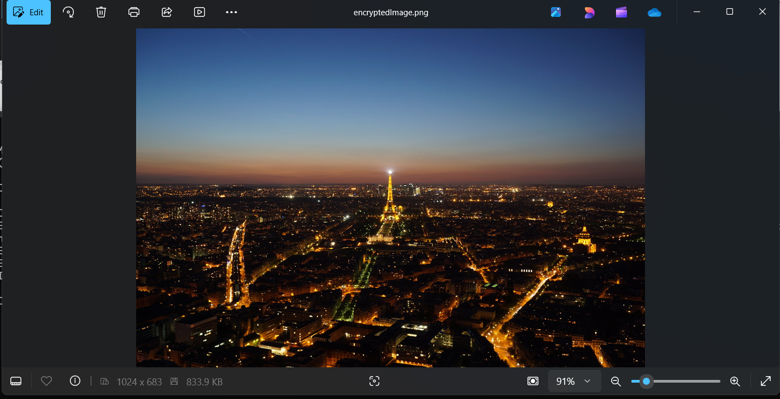
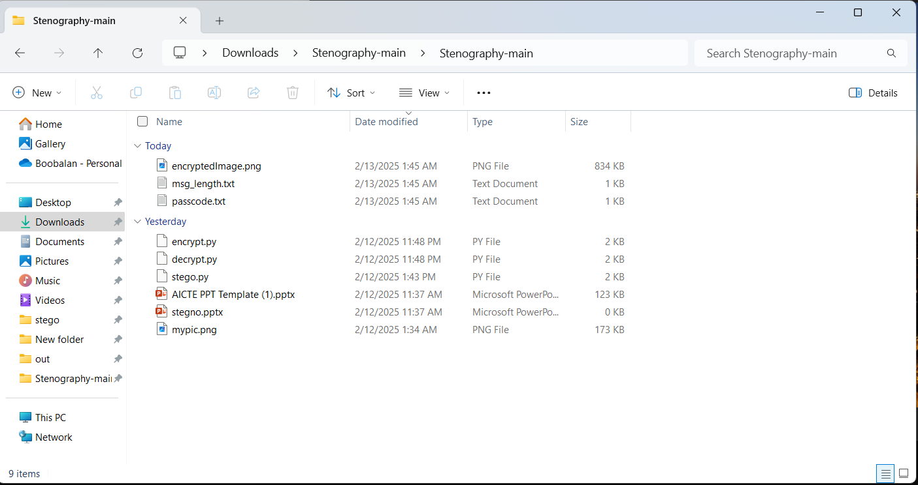
Results
Sample Output
Original Image
Encrypted Image
Files List

Slide 8
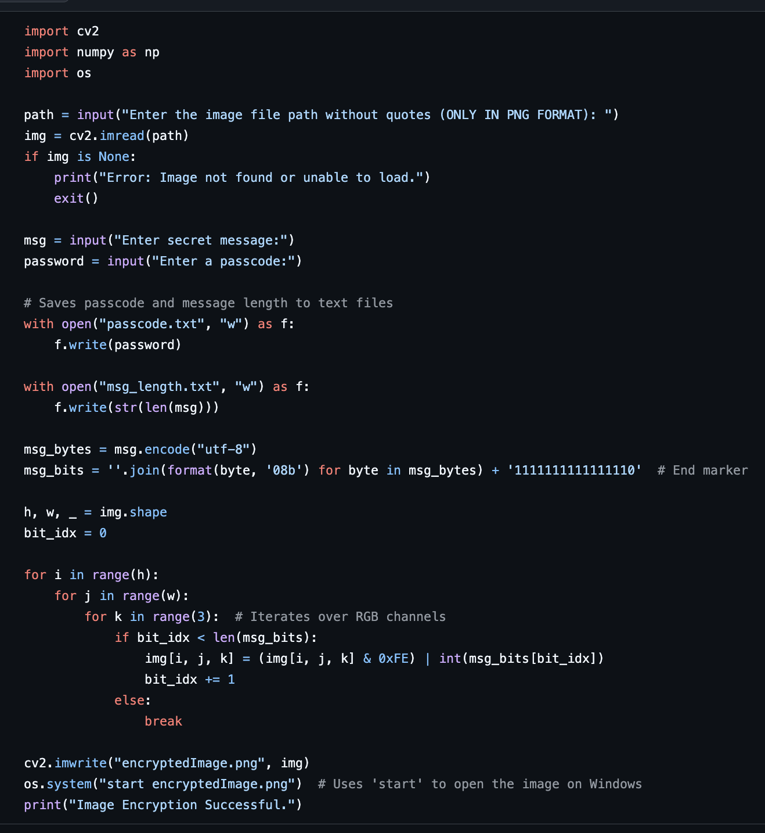
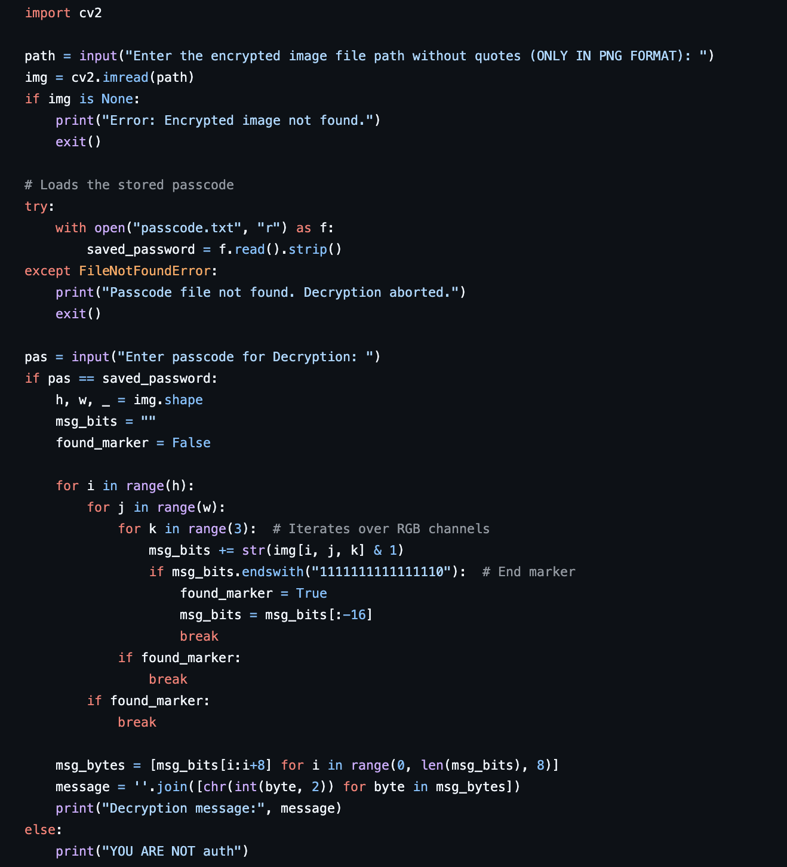
Results
Encryption Code Decryption Code

Slide 9
Conclusion
This project successfully implements image steganography using LSB (Least Significant Bit) encoding, providing a secure and undetectable method for embedding secret messages inside images. By leveraging Python, OpenCV, and NumPy, the project ensures efficient message encryption and decryption while maintaining the visual integrity of the image. The use of passcode protection further enhances security, ensuring that only authorized users can access the hidden data.
The project effectively addresses the problem of secure communication in an era where digital privacy is constantly under threat. Unlike traditional encryption methods that make the presence of confidential data obvious, steganography conceals the existence of data entirely, making it far more difficult for attackers to detect or intercept.
Furthermore, this implementation is lightweight, offline, and user-friendly, allowing users to input custom images dynamically without modifying the source code. By using PNG format, the project avoids the pitfalls of lossy compression, ensuring that hidden data remains intact.
Overall, this steganography solution provides a practical and efficient means of securing confidential information, with real-world applications in cybersecurity, forensics, journalism, and personal privacy. Its ability to embed data in a visually imperceptible manner makes it a powerful tool for covert communication and secure data storage.

Slide 10
GitHub Link
https://github.com/SilverOwl1112/Steganography-Project-AICTE---Edunet-Foundation---IBM-Skillsbuild-Cybersecurity-Internship-2025.git
The README file section in this GitHub repository has all the steps needed to execute and use this project.

Slide 11
Future scope
🔹 Enhanced Security with Advanced Encryption Techniques While the current implementation uses passcode protection, future enhancements could incorporate AES (Advanced Encryption Standard) or RSA encryption before embedding the message in the image. This would add an extra layer of security, ensuring that even if someone extracts the hidden data, they cannot decipher it without the proper encryption key.
🔹 Support for Multiple Image Formats Currently, the project is optimized for PNG images due to their lossless compression. Future developments could expand support to BMP, TIFF, and RAW image formats, allowing for greater flexibility in choosing cover images while ensuring message integrity.
🔹 Increased Data Capacity Using Adaptive Steganography The project currently relies on LSB encoding, which has a limited storage capacity. Future improvements could include adaptive steganography techniques, such as spread-spectrum or frequency-domain embedding (DCT/FFT-based methods), enabling larger data storage without noticeable image distortion.
🔹 Graphical User Interface (GUI) for User-Friendly Experience To make the tool more accessible to non-programmers, a GUI-based application could be developed using Tkinter, PyQt, or Flask. This would allow users to easily select images, enter messages, and decrypt data without using the command line.
🔹 Steganalysis Detection and Counter-Steganography Measures Future iterations of the project could include steganalysis detection to identify whether an image has hidden data. This feature could be useful for forensics and security professionals in detecting unauthorized steganographic usage. Additionally, implementing counter-steganography techniques could help in protecting images from unauthorized embedding.
🔹 Cloud-Based Secure Data Hiding A potential future enhancement could involve cloud-based steganography, where users can securely encrypt, store, and share steganographic images through an online platform. This would allow for secure remote communication while ensuring accessibility from multiple devices.
These advancements would make the project more secure, efficient, and user-friendly, opening up possibilities for broader adoption in real-world applications.

Slide 12
THANK YOU

